Slide 1
PM10 Air Pollution Analysis (Part 2)
Michael Trossbach
ST765

Slide 2
Analysis Objectives
Compare various the performance of various models
Ordinary Least Squares
ANOVA
Lasso
Ridge Regression
Visualize the data in two dimensions using PCA
Are there separable classes?

Slide 3
What is PM10 air pollution?
PM stands for particulate matter (also called particle pollution): the term for a mixture of solid particles and liquid droplets found in the air.
PM₁₀ (coarse particles) describes inhalable particles, with diameters that are generally 10 micrometers and smaller.
SOURCE: https://www.epa.gov/pm-pollution/particulate-matter-pm-basics#PM

Slide 4
Data
Response variable:
logarithm of the concentration of PM10 (micrograms per meter³ of air) at the given hour of day
Explanatory variables:
logarithm of the number of cars per hour
temperature 2 meters above ground (degree C)
wind speed (meters/second)
temperature difference between 25 and 2 meters above ground (degree C)
wind direction (degrees between 0 and 360)
hour of day
day number from October 01, 2001
Subsample of 500 observations from a data set collected by the Norwegian Public Roads Administration in the neighborhood of Alnabru in Oslo, Norway between October 2001 and August 2003.
DATA SOURCE: http://lib.stat.cmu.edu/datasets/PM10.dat

Slide 5

Data Preparation
D
D
Create variable for period of day using hour of day variable (integer ranging from 1 - 24)
Early morning: 1 - 4
Mid morning: 5 - 8
Mid day: 9 - 12
Early afternoon: 13 - 16
Late afternoon: 17 - 20
Night: 21 – 24
Normalize numeric columns
$$\frac{x−\min\left(x\right)}{\max\left(x\right)−min⁡(x)}$$
Determine date of each observation
Start date (October 01, 2001) + number of days from start date (a variable included in data set)
Create variable for season
Spring: March - May
Summer: June - August
Fall: September - November
Winter: December - February

Slide 7
Model Comparisons
Mean Squared Error Using Test Data
 | 60% Training, 40% Test | 70% Training, 30% Test | 80% Training, 20% Test | Average Error
Linear Model #1 | 0.0241 | 0.0242 | 0.0252 | 0.0245
Linear Model #2 | 0.0309 | 0.0287 | 0.0291 | 0.0296
Linear Model #3 | 0.0230 | 0.0238 | 0.0259 | 0.0242
ANOVA | 0.0241 | 0.0259 | 0.0264 | 0.0255
Lasso | 0.0269 | 0.0252 | 0.0257 | 0.0259
Ridge Regression | 0.0270 | 0.0262 | 0.0264 | 0.0265

Slide 8
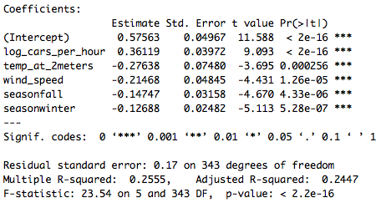
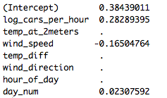
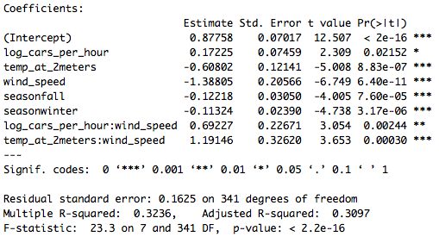
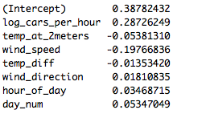
Lasso vs. Ridge vs. OLS According to 70% training, 30% test split
Linear Model #1
Lasso Model
Linear Model #3
Ridge RegressionModel

Slide 9
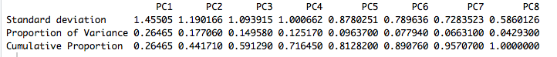
Principal Component Analysis
The scree plot provides a visual understanding that there is an elbow-like bend at the second principal component.
The cumulative proportion of variance explained by the first two principal components though is only 44.17%, which is not an exceptionally high proportion of variance.

Slide 10
Principal Component Analysis Season
Not separable into classes according to season based on the first two principal components

Slide 11
Principal Component Analysis Time of Day
Potential grouping into two classes according to time of day based on the first two principal components

Slide 12
Conclusions
Lasso was the most parsimonious model, though it did not attain the lowest mean squared error.
When viewed in two dimensions according to time of day, there appear to be two approximately distinct classes. The two classes are:
morning
mid-day + night

